Slide 1

Logistic Regression
MODEL 1

Slide 2
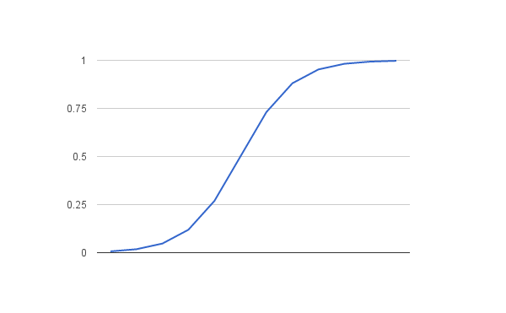

Logistic Function
$$\frac{1}{1+ e^{−value}}$$
Notes:
Logistic function aka sigmoid function, was developed to describe population growth, rising quickly and maxing out at the carrying capacity of the environment. 1 / (1 + e^-value).
In logistic regression, input values (x) are combined linearly using weights or coefficient values (beta) to predict an output value (y). y = e^(b0 + b1*x) / (1 + e^(b0 + b1*x)).
B0 is the bias or intercept term and B1 is the coefficient of single x (input value).

Slide 3
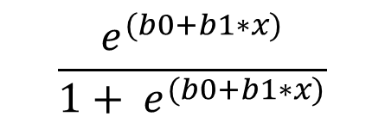
Logistic Regression
$$\frac{e^{(b0+b1∗x)}}{1+ e^{(b0+b1∗x)}}$$
Notes:
Logistic function aka sigmoid function, was developed to describe population growth, rising quickly and maxing out at the carrying capacity of the environment. 1 / (1 + e^-value).
In logistic regression, input values (x) are combined linearly using weights or coefficient values (beta) to predict an output value (y). y = e^(b0 + b1*x) / (1 + e^(b0 + b1*x)).
B0 is the bias or intercept term and B1 is the coefficient of single x (input value).

Slide 4

Logistic Regression
b values are estimated from the training data
  Maximum-likelihood estimation:
    Minimize error in probabilities predicted by the model to those in the data
    Or probability of near zero that the person is male.
y = $\frac{e^{(−100+0.6∗150)}}{1+ e^{(−100+0.6∗x)}}$
y = 0.000045
Notes:
Logistic function aka sigmoid function, was developed to describe population growth, rising quickly and maxing out at the carrying capacity of the environment. 1 / (1 + e^-value).
In logistic regression, input values (x) are combined linearly using weights or coefficient values (beta) to predict an output value (y). y = e^(b0 + b1*x) / (1 + e^(b0 + b1*x)).
B0 is the bias or intercept term and B1 is the coefficient of single x (input value).

Slide 5
Example
Problem: make a prediction (1) female or (2) male based on height.
  Given: Height = 150cm (~ 4’ 9”)
  Estimated b0 = -100, b1 = 0.6
Notes:
Logistic function aka sigmoid function, was developed to describe population growth, rising quickly and maxing out at the carrying capacity of the environment. 1 / (1 + e^-value).
In logistic regression, input values (x) are combined linearly using weights or coefficient values (beta) to predict an output value (y). y = e^(b0 + b1*x) / (1 + e^(b0 + b1*x)).
B0 is the bias or intercept term and B1 is the coefficient of single x (input value).

